Slide 1
INFO3111: C++ 3D Graphics
Lasciate ogne speranza, voi ch'entrate
With You Host: Michael Feeney

Slide 2
Who am I?
Michael Feeney
LDB (130 Dundas)
I coordinate GDP1 (Game Development – Advanced Programming):
I used to coordinate (for a decade or so): CPA2 & 3
“Teach” in GDP1 and CPA
mfeeney@fanshawec.ca
(Note: mfeeney@fanshaweonline.ca forwards to the above e-mail)
This one.

Slide 3
What’s this course about?
See the CIS (or whatever that’s called now) on FOL
Intro to (soft) “real time” 3D graphics using a C/C++ API. Popular ones:
DirectX (aka Direct 3D), OpenGL, OpenGL ES, Vulkan
The “C/C++” part come into play with:
Choosing the API (not Java, Python, whatever…)
And, yes, I am very well aware that there are “wrappers” to other languages… ☺
Everything that “supports” and organizes the 3D output:
There’s an “animation” component to this, too: things “move/change over time”, so how do we pull that off, in (soft) real time, using C/C++?
How do we manage/maintain/extend this little “framework” we have?

Slide 4
What’s this course about?
Popular ones:
DirectX (aka Direct 3D), OpenGL, OpenGL ES, Vulkan
This term, we’ll be using OpenGL 4.6 (+glad, GLFW, and glm)
(or maybe 3.3... more on this in a moment)
I may show you some Vulkan, too, but we’ll see how it goes…

Slide 5

3D!! OpenGL!!! C++!!! SWEET, dude!
Let’s write Halo 9! Today!! RIGHT NOW!!!
Hold on, poncho
It’s an introduction
You need to walk before running
Some of this stuff is pretty hard
There’s some math in here
And a lot of it isn’t intuitive at all…
What CPAs find “challenging” tends to be a little unexpected (more in a moment)

Slide 6
What do you need?
Your brain
Visual Studio 2019/2022 Community Edition
Note: your solutions need to run on my machine (I’ve got 2017, 2019, 2022 installed)
Note: You can install all of these at the same time, without any problems
The C/C++ compilers are identical to the other versions (like VS Enterprise, Galactic, World Domination, etc.)
GLFW, glad, and glm

Slide 7

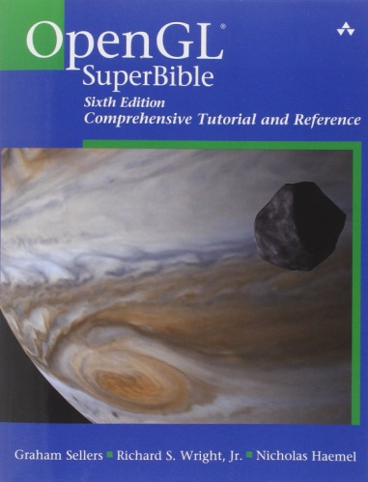
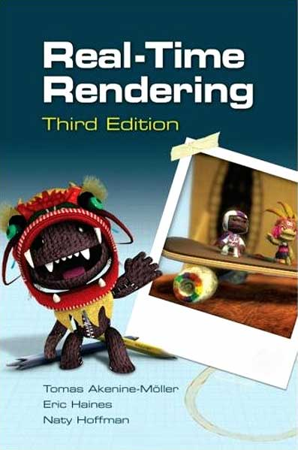
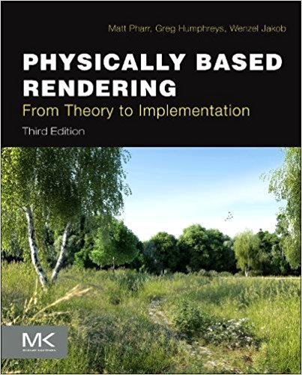
Some suggested books (OpenGL)
OMFG! That’s, like, THE TEXTBOOK!!!
#mindblown
OpenGL SuperBible: Comprehensive Tutorial and Reference (7th Edition); (2016), by Graham Sellers (OpenGL driver team for AMD), Richard S. Wright , Nicholas Haemel, ISBN-10: 0321902947, ISBN-13: 978-0672337475, Addison-Wesley Professional
And if you are really into graphics and NOT a noob: (and have $$) →
This book won an Academy Award. True Story: https://www.youtube.com/watch?v=7d9juPsv1QU
Notes:
http://advancedesl.files.wordpress.com/2011/01/15.jpg

Slide 8
The “online” part
Yes, “online” sucks. I know.
This is a 7 week course
It’s all on zoom
Streams are recorded for later viewing
Help sessions (TBD)

Slide 9
What you should know (or will know, soon)
Some C++, and how C++ projects build
compile vs. link, #include issues, file scope, etc.
Some STL (vector, string, map, etc.)
Some basic algorithm stuff, maybe
Including the basics of the STL algorithm
Note: my def. of algorithm might be very, very different from yours… heads up
Some debugging skills
How to pay attention
How to keep “plugging along” (Coolidge)
Don’t know some (all?) of that?
Well, that’s why you’re in school, right?

Slide 10

What you want to know...
You
What you already know
Valley of confusion, lack of knowledge and skill, and frustration...
Notes:
http://hinglecoaching.com/images/mission%20man2.jpg

Slide 11
But I’m, like, SUPER IMPATIENT, man!!!
Why can’t we do something, like, TODAY!?
I mean, we could use, like, a GAME ENGINE!
Or Flash? HTML 5.0? Or Unity?? Why not that? It’s so “easy”!
Come ON!!!
...Let me give you two analogies...

Slide 12
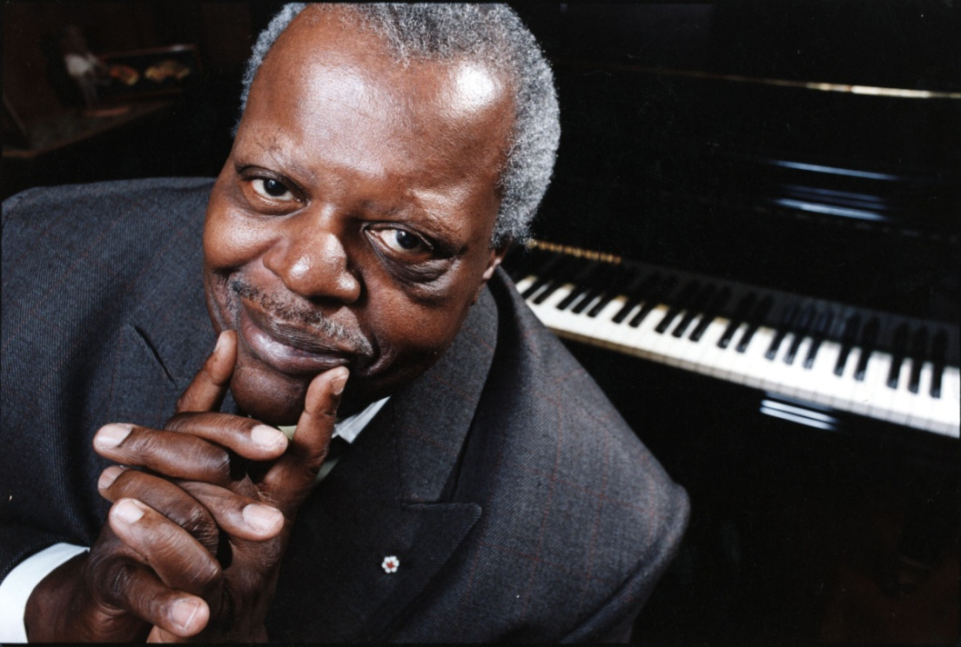

This is Glenn Gould & Oscar Peterson
They were two of the greatest piano players in history
If you wanted to play like these guys, how would you go about it?
Notes:
http://www.thestar.com/content/dam/thestar/entertainment/music/2013/11/07/oscar_peterson_award_to_be_handed_out_at_york_u_gala/oscar_peterson.jpg
http://www.parkinggaragepolitics.com/wp-content/uploads/2013/03/Glenn-Gould-Source-Unknown.jpg

Slide 13
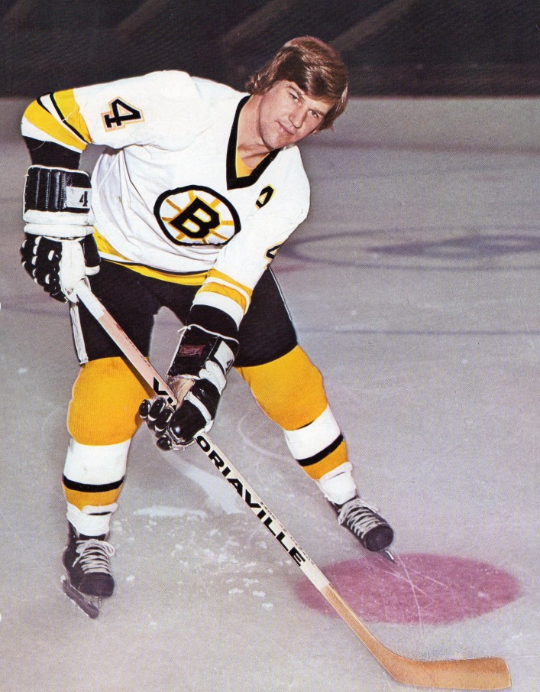

Or how about Bobby Orr or Wayne Gretzky?
Again, if you wanted to play like these guys, how would you go about it?
Notes:
http://i.cdn.turner.com/si/multimedia/photo_gallery/1004/revolutionary.moments.in.sports/images/wayne-gretzky.jpg
http://www.bobbyorrcollector.com/wp-content/uploads/2011/11/img165-784x1024.jpg

Slide 14
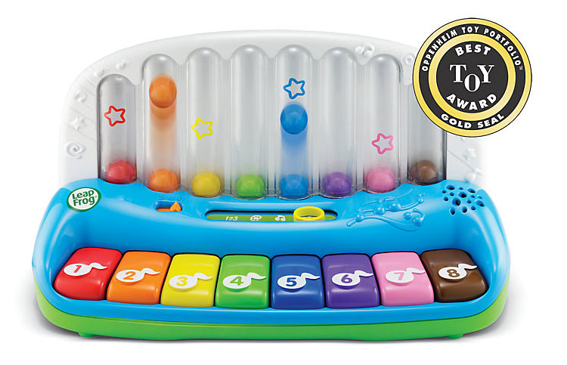

Simple, but no simpler…
Well, we could start with something like this...
But eventually, we’d have to use the real thing.
Notes:
http://images.amazon.com/images/G/01/toys/detail-page/c26-B00804BDE0-1-l.jpg
https://img1.etsystatic.com/000/0/6308893/il_fullxfull.305981903.jpg

Slide 15
Commercial graphics APIs… (DirectX, OpenGL, Vulkan, Metal, etc.)
Are very mature
Aren’t intended to be “for beginners”
There’s a lot of things that can “go wrong”
There’s a lot of things you have to know before you can be even remotely productive
(Just like playing an instrument...
...or being ½ way useful at a sport, right?)
You’re going to screw up/fall down... a lot.
They are very low level (are “C”, NOT “C++” APIs)

Slide 16

Michael’s hand
(normally not yellow)

Slide 17
What’s this course not about (1/5)?
Ray-tracing.
Old OpenGL (fixed function pipeline)
Pre OpenGL 2.0 (glVertex(), etc.)
DirectX : Although there are a lot of similarities with OpenGL
GDI, GDI+, Flash, HTML 5, WebGL, or any other graphics APIs
OpenGL ES (mobile), mainly because the emulators for desktop are crappy. ES is very similar in many ways to OpenGL, post 3.3.

Slide 18
What’s this course not about (2/5)?
Crazy game stuff and/or “using a game engine”
While we will look at some things, this is not a “let’s get endlessly distracted from graphics” course
I will talk to you (off line) about whatever you like, but the thrust here is an intro to graphics using a C/C++ API
But, don’t fret, we’ll do some pretty neat stuff
Why? We don’t have time; there’s too much to cover as is.

Slide 19
What’s this course not about (3a/5)?
“Stupid” unnecessary programming/C++ stuff:
Pointless (aka. unnecessary) templates
Why use templates, BTW? Really, what are they for?
Note: I didn’t say “templates == bad”. Why are you making that function/method/class a template?
If it’s because “it makes it better”, then you’re an idiot misinformed.
Pointless (unnecessary) classes/inheritance
Any combination of the words “best” and “algorithm”
Why do you even program? Why use a computer?
The “point” of programming is to make something.
Read that line above, again.
Unlike life, it’s the destination NOT the journey.

Slide 20
What’s this course not about (3b/5)?
Making “the trivial” impossible to understand
Supposed to be: making the complicated, simpler
If you can’t follow the code (in minutes), then it’s:
Inherently super complicated (hardly ever the case)
It’s garbage:
http://firstround.com/article/why-firing-brilliant-assholes-is-required-to-build-a-great-engineering-culture
http://scottberkun.com/2007/asshole-driven-development/
http://andytroutman.com/articles/2013/01/24/rockstar-programmers-are-not-assholes.html
https://www.youtube.com/watch?v=P3fqetErxjA (5 second rule)

Slide 21
Start of: “rant” about the C++ committee
If you are unaware of the committee, let me expand your mind…
X
(You can skip to slide 29 if you’d like)

Slide 22
X
(You can skip to slide 29 if you’d like)

Slide 23
What’s this course not about (4/5)?
boost and other 3rd party libraries.
So to clarify: NO boost or any other 3rd party libraries “general” C/C++ libraries (glm/glad, etc. are math/graphics, so not “general”)
If you use boost in your exams or projects, they will not be marked. Find another way.
If you *really* need some 3rd party library (and you don’t BTW), then clear it for me first. But really? You “need” it?
boost is fine and all, but:
boost is *written in* C++, but
boost != C++

Slide 24
What’s this course not about (5/5)?
C++11/14/17/20/Whatever
This is the ever changing C++ standard
Remember that the last standard was…
Hmmmm, things were A.O.K. for 16 years….
Keep in mind that “new and sexy” isn’t the same thing as “better” or “actually used in industry”
The committee doesn’t actually represent the industry
Look it up – see who’s on it
Not really widely adopted (see 1998 point, above)
Many people don’t even use the STL (or even templates), so good luck using C++11. Many only just support C++98
Some systems don’t even support C++…
wait for it…
98/2003
(as in 1998)

Slide 25
C++ 11/14/17/20/whatever “rant” (part 1 of 3):
NOT a “fundamental change” to the language
Slight change at best
Superficial/sort-of-helpful “prettiness” features
Lambda functions:
Neat, but now people are writing ones that are multiple screens long, defeating the purpose… what do they replace, by the way?
foreach: sure, but is wring a “for” /that/ hard, muffin?
nullptr: yeah, that’s sort of a good thing
“move” semantic: yeah, that’s nice, too
enum improvements: sure, but meh
Some good things: noexcept, etc.

Slide 26
C++ 11/14/17/20/whatever “rant” (part 2 of 3):
Examples of what the committee has said:
They want to “deprecate raw pointers” and “remove C”
They think that C++ has to be “improved” because it has fewer library functions than Java.
Think “rand” is “worse than goto”. Really.
Don’t listen to the industry at all: STL/Silicon Graphics, “space ship operator”, the list goes on.
Most aren’t even developers – many are journalists

Slide 27
Videos we’ll look at in a moment
https://youtu.be/PqU_ot4BlNQ?t=467
https://youtu.be/7P536lci5po?t=995
https://youtu.be/7P536lci5po?t=2427
https://channel9.msdn.com/Events/GoingNative/2013/rand-Considered-Harmful
https://www.youtube.com/watch?v=rX0ItVEVjHc

Slide 28
“New” C++ Standard
Threading? Sure, but the “jury is still out” on implemntation
At “C++ Now”, 2013, the Visual Studio guys suggested /not/ relying on it for speed… what now?
There are other, competing, methods (TBB, etc.)
Besides, they are based on Java thread model (so not at all new, really)
Initializes:
int myArray[] = { 1, 2, 3, 4, 5 };
vector<int> myVec = { 1, 2, 3, 4, 5 }; // Invalid in C++ 98, but…
… it’s not the same thing /at all/. KNOW THE DIFFERENCE
auto: why? It’s a strongly typed language (at compile time)
Have the compiler “take care” of the types? Wow. Danger Will Robinson! Added to make templates easier to use. That’s it.
You trade “specifying types” with “guess what the compiler will pick”

Slide 29
C++ 11+ “rant” clarification:
C/C++ are “strongly typed”, “non-managed” languages
They were never intended to be weakly typed/managed
The API we’re using is in C
Most of the new features won’t likely help, much
Using the newer code isn’t automatically “better”, so doing it using core C++ isn’t “worse” or “bad”
Seeing it another, simpler way, might help you
Why so many standards? To fix past mistakes?
How much compiler support is there?
I don’t really care, but don’t test my patience.

Slide 30
C++ and graphics APIs
Many “C++” APIs are really in C
Win32 (windows), Linux, embedded, DirectX, OpenGL, Vulkan, etc., etc.
So our code will be in C++, but using a “C” API.
Think:
ASP/whatever, when everything is really JavaScript
Or
JavaScript, when we’re really communicating with HTML+JSON

Slide 31
How you pass

Slide 32
Your marks…
“Project” mark: 40%
10-12 checkpoints worth 10% TOTAL
(Lowest 2 marks will be dropped, so you can miss 2)
2 projects worth 15% each
Projects are due right before the exam, and are intended to help you prepare for the exam
“Exam” mark: 60%
Midterm and final (each 30%)
50% is a “pass” in this AND EVERY OTHER course.

Slide 33
Checkpoints: 10%
Assigned at the end of class
Due at the start of the next class
There are no extensions or late marks, since I’ll be giving you the solutions.
You should do them yourself.
There are no late marks (since I will be giving a solution at the next class.)
There might be a “bonus” checkpoint at the end, worth 2%, added directly to your mark (up to the 40% of the “projects” portion)
The students who do their own checkpoints tend to do better on the exams. Really?! Who would have thought?

Slide 34
2 Projects: 15% each
Due right before the exams.
Unless there are “exceptional circumstances” (Policy A-131), if you miss the deadline, you get zero (that is the policy, by the way)
You should do them yourself.
There are no late marks
Unless there are “exceptional circumstances” (Policy A-131)
If you miss the deadline, you get zero (that is the policy, by the way)
Projects are intended to help you with the exam. i.e. if you did well on your project (delivered what I ask for) then you should pass the exam.

Slide 35
2 Exams: 30% each
2 of them: mid-term (around day 7/8) & final (day 14/“exam week”)
“3 hours” in that you can do it in 3 hours.
If we were in class, it would be in a 3 hour block with no internet.
Fun fact: that’s what they used to be. Who knew?
It’s take home. Due 24 hours after assigned (we’ll discuss this later)
All previous mid-terms are finals will be posted and available before you write (so you can look at them).

Slide 36
“Part marks”
Students seem to love “part marks.”
Now, I’ll try really hard to be fair, but:
Have you ever had a plumber “almost” fix your toilet?
Did you pay them?
Ever “sort of” broke your leg?
Get a cast for that?
Ever “almost” paid your mortgage?
How did the bank like that?
Did you buddy “almost” pay you that $50 they owe?
Did you call that square?
Would you loan them money again?
If your code won’t build, then I can’t mark it. Period.
You can’t “almost” meet a checkpoint.

Slide 37
boost
If you use boost:
You will get a mark of zero (0)
Because it won’t build:
I won’t include boost, and
I’ve set my compiler to prevent C++11 things
(Install VS2008, then set the “toolset” to “v90”)
I will rebuild with 2012/13/15/17 (so you get “the latest” compiler)
If this scares/outrages you, then:
Why? Really, I’m serious: why is that such a #bigfreakingdeal?
Bear with me... (there’s a #verygoodreasonforthis)
Also, it’s cute you have an opinion; really, how much have you been paid (and currently) for doing C/C++ development? Oh, right…

Slide 38
Other rants I should clear up (3/4):
Templates are a code generation tool, when there is overloading.
It’s certainly not the first one, and not even “the best one”:
think about it: I bet you could come up with some “meta” language do spit out specific “C” code.
Oh, and that “C++” code that gets generated? Like the “methods” and whatnot…
Like “the spoon” in the Matrix, methods don’t exist. Really, let’s see… (linker error)
Before you “template” something, think about why you’re doing it. If it’s for some potential, theoretical future use, then you’re really just doing “intellectual masturbation”

Slide 39
Remember:
The reason you program is to make something.
It’s like playing with LEGO:
Do you want to make The Thing You Want?
…or are you more interested in:
Every possible way certain LEGO pieces can go together?
Arguing about “the best” or “most modern” way to put together LEGOs? Or belittling people for “doing it wrong”?
Programming is a tool to get stuff made. Like words make stories. Or pots make food. Or instruments make music.

Slide 40
Other rants I should clear up (4/4):
“Performance:”
While you can ask, please don’t waste everyone’s time arguing in class with me about performance myths.
Most of my career was (and is) in embedded/real-time environments.
Use a vector first, unless you have a reason not to (like map).
If you’re using C, then just make an array (or a struct with the array and the size of the array – C doesn’t know how big an array is)
++i vs i++. Perhaps, but seriously, *that’s* killing your performance? I seriously doubt it.
Prove to me that it’s a performance hit.
The code here is for clarity first. 99.999% of all code should be.
Make the damn thing work first, then think about performance, but ONLY if you can PROVE IT.
But let me show you what I mean...
Then don’t change it... yet.

Slide 41

Good news, everyone!
We’re going to code now!

Slide 42
And now…
…enough goofing around…
Ladies and Gentlemen, start your Browser and Visual Studio.
There’s some links:
https://glm.g-truc.net/0.9.9/index.html (glm)
https://www.glfw.org/ (glfw)
https://glad.dav1d.de/ (OpenGL glad)

Slide 43
CPU 4.0Gx16
32-1000
GPU : 6144 Core
65,000 REG
CODE
Code
RAM 32G
RAM 8G
CODE
HDD

Slide 44
CPU 4.0Gx16
32-1000
GPU : 6144 Core
65,000 REG
CODE
Code
RAM 32G
RAM 8G
CODE
HDD

Slide 45
Feeney’s copy (origin)
Your local copy

Slide 46
Mike Acton ; 3 lies
https://cellperformance.beyond3d.com/articles/2008/03/three-big-lies.html
Software is a platform
PS3 game -> Atari 2600
Code should be designed around a model of the world
Code is more important than data

Slide 47
Data
Code
Data

Slide 48
OpenGL libraries, etc.
OurProgram.cpp → .obj
glCreateShader() → library (.lib)
Linker:
Combine these → exe

Slide 49
OpenGL libraries, etc.
Where are the OpenGL calls?
Glad: https://glad.dav1d.de/
OpenGL knows nothing about the OS or the screen
GLFW – windows, mouse, keyboard, etc.
Math:
glm

